Slide 1

Gig Worker Wage Analysis
Nelcy V
2548419

Slide 2

Problem Statement
Gig workers (delivery workers, ride-share drivers, etc.) often:
Work long hours
Face fuel cost fluctuations
Experience strike days
Have varying income per delivery

Slide 3
Dataset Overview
This dashboard is built using a synthetic dataset containing:
City
Platform
Hours Worked
Distance Covered (km)
Deliveries
Earnings
Petrol Cost
Penalty
Net Income
Strike Day Indicator

Slide 4
Dashboard Overview
This dashboard contains:
Earnings vs Petrol Cost (Comparison)
Income per Delivery Analysis
Strike Day Trend
Expense Breakdown (Donut Chart)
Distribution Analysis (Histogram / Boxplot)
Relationship Analysis (Scatter Plot)

Slide 5
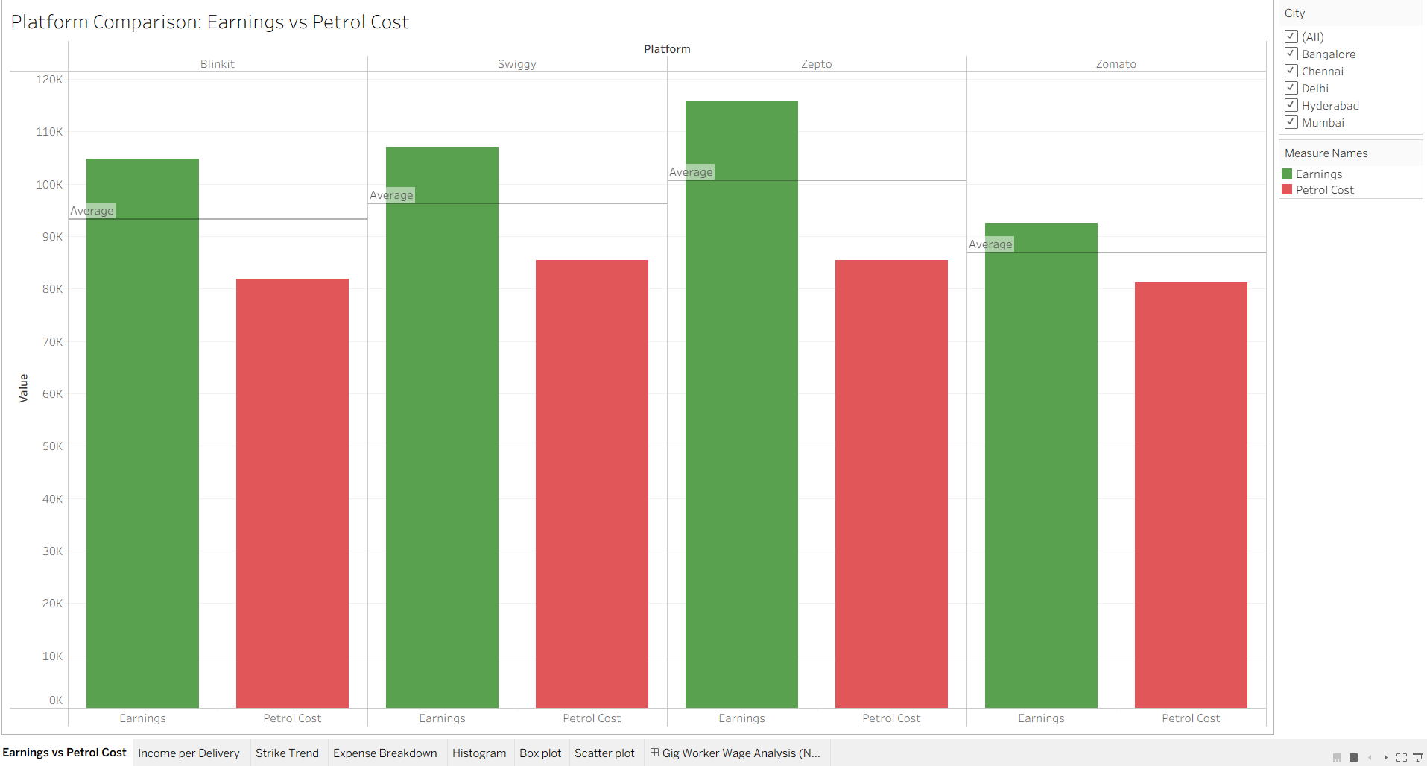
Earnings vs Petrol Cost (Bar Chart)
What it shows:
Total Earnings
Total Petrol Cost
What it measures:
Cost impact on revenue.

Slide 6
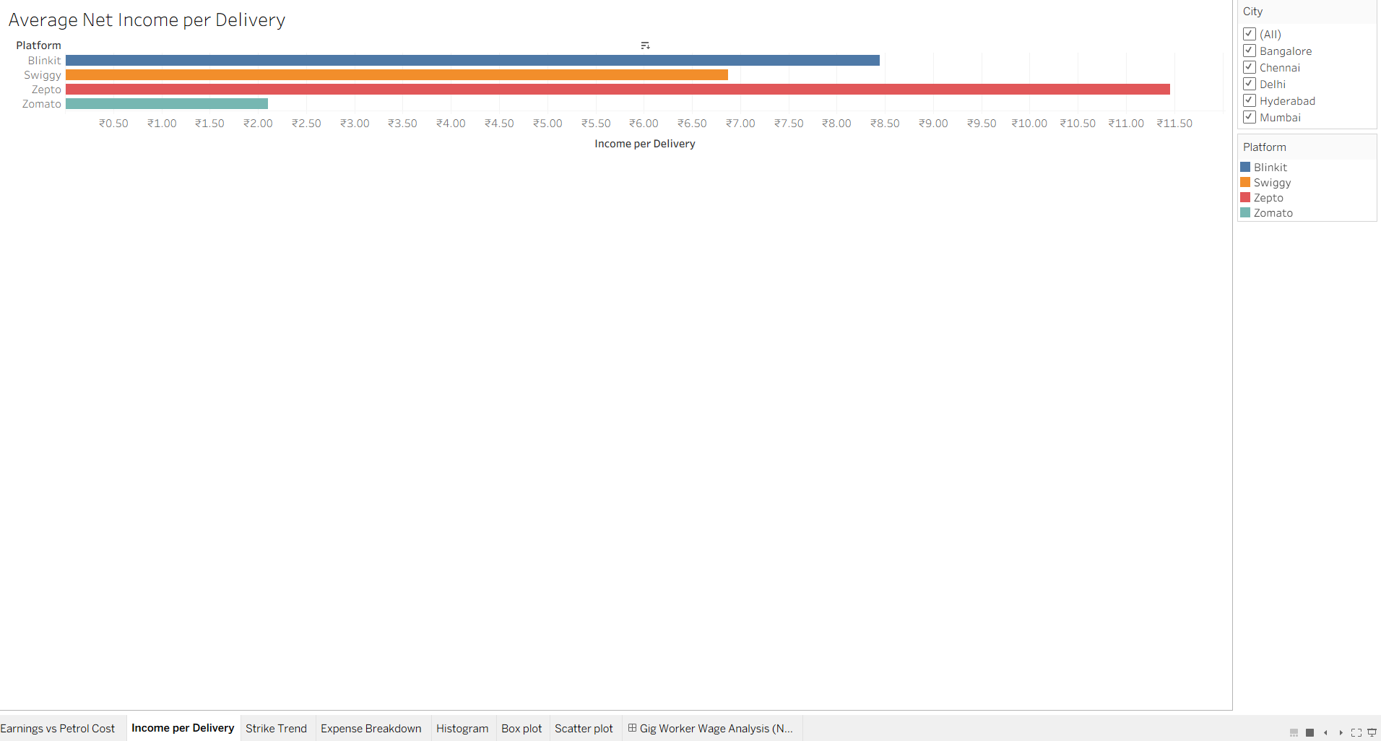
Income per Delivery
What it shows:
Average income earned per delivery.
What it measures:
Worker efficiency.

Slide 7
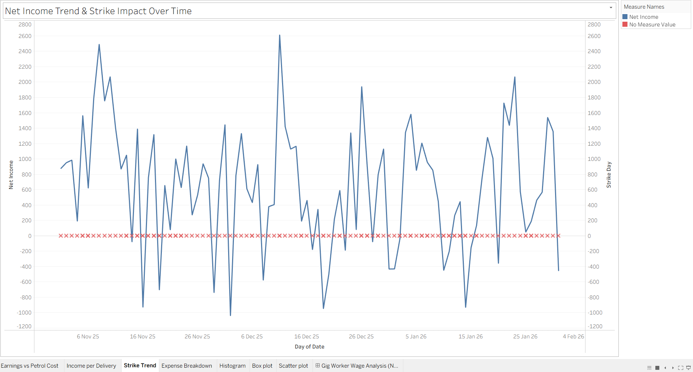
Strike Day Trend
What it shows:
Impact of strike days on income.
What it measures:
Income instability.

Slide 8
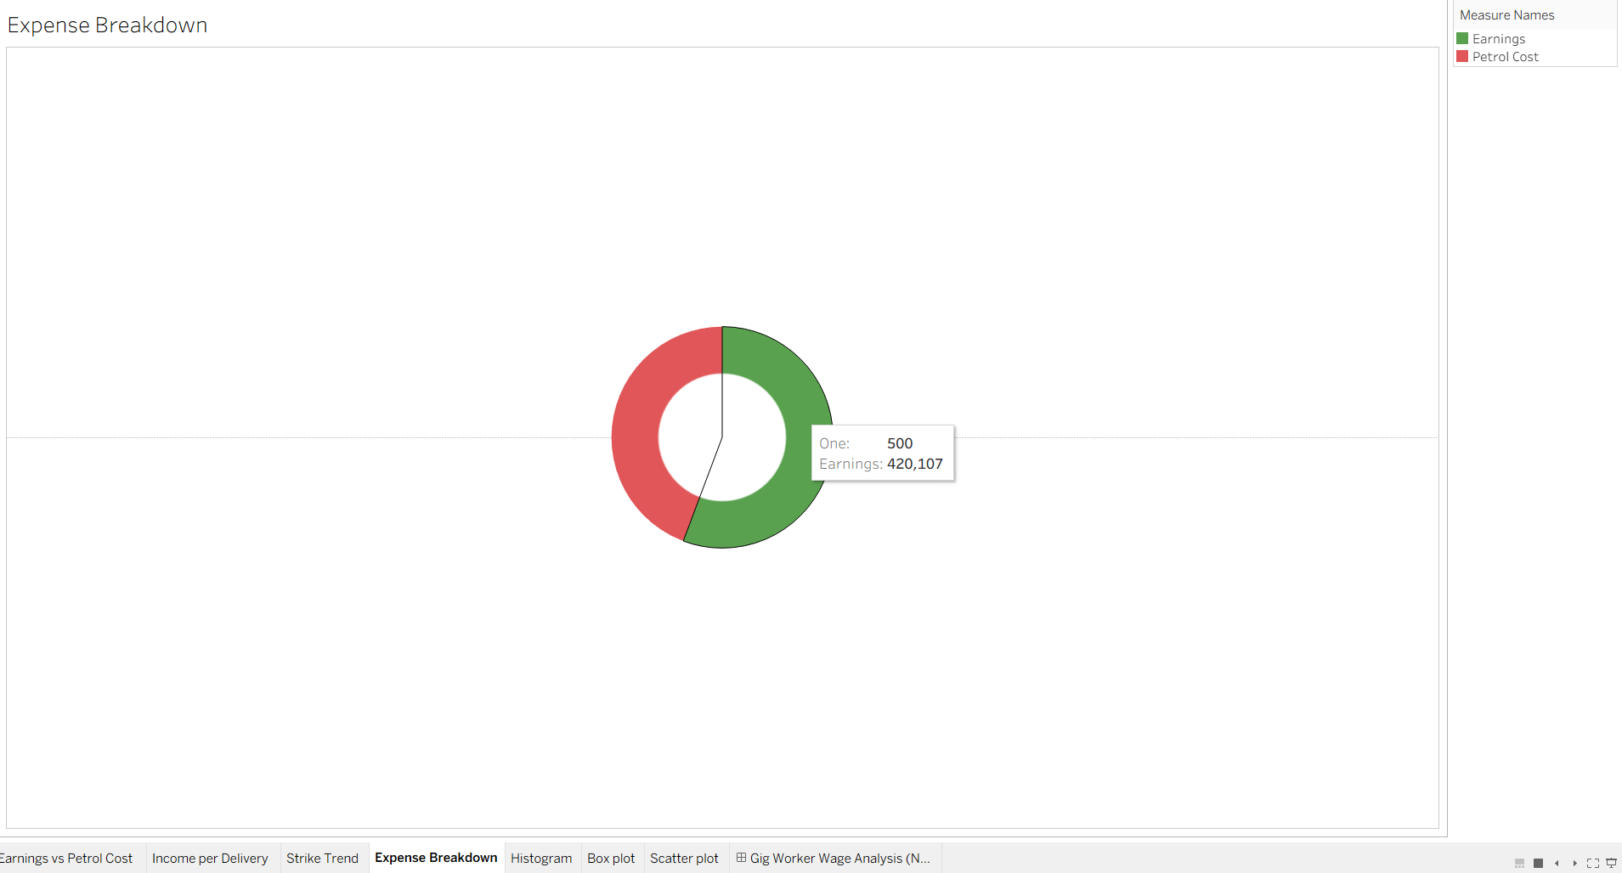
Expense Breakdown
What it shows:
Earnings
Petrol Cost
Visualized as a donut chart.
What it measures:
Percentage of income consumed by fuel expenses.

Slide 9
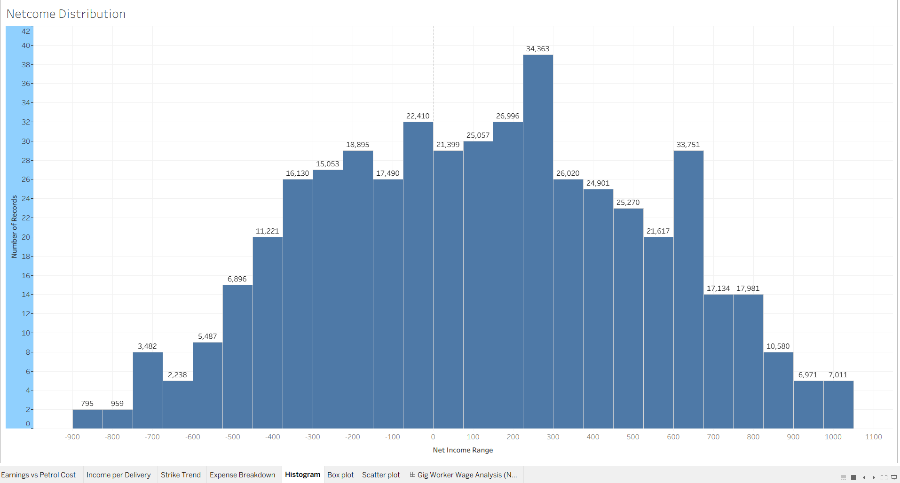
Distribution of Net Income
What it shows:
Distribution of net income among workers.
What it measures:
Income spread and inequality.

Slide 10
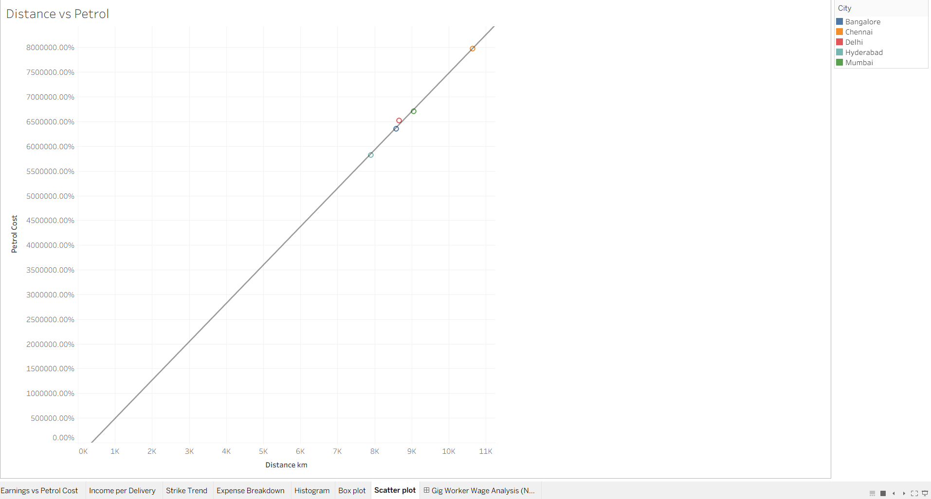
Scatter Plot
What it shows:
Relationship between:
Hours Worked
Earnings / Net Income
What it measures:
Correlation.

Slide 11
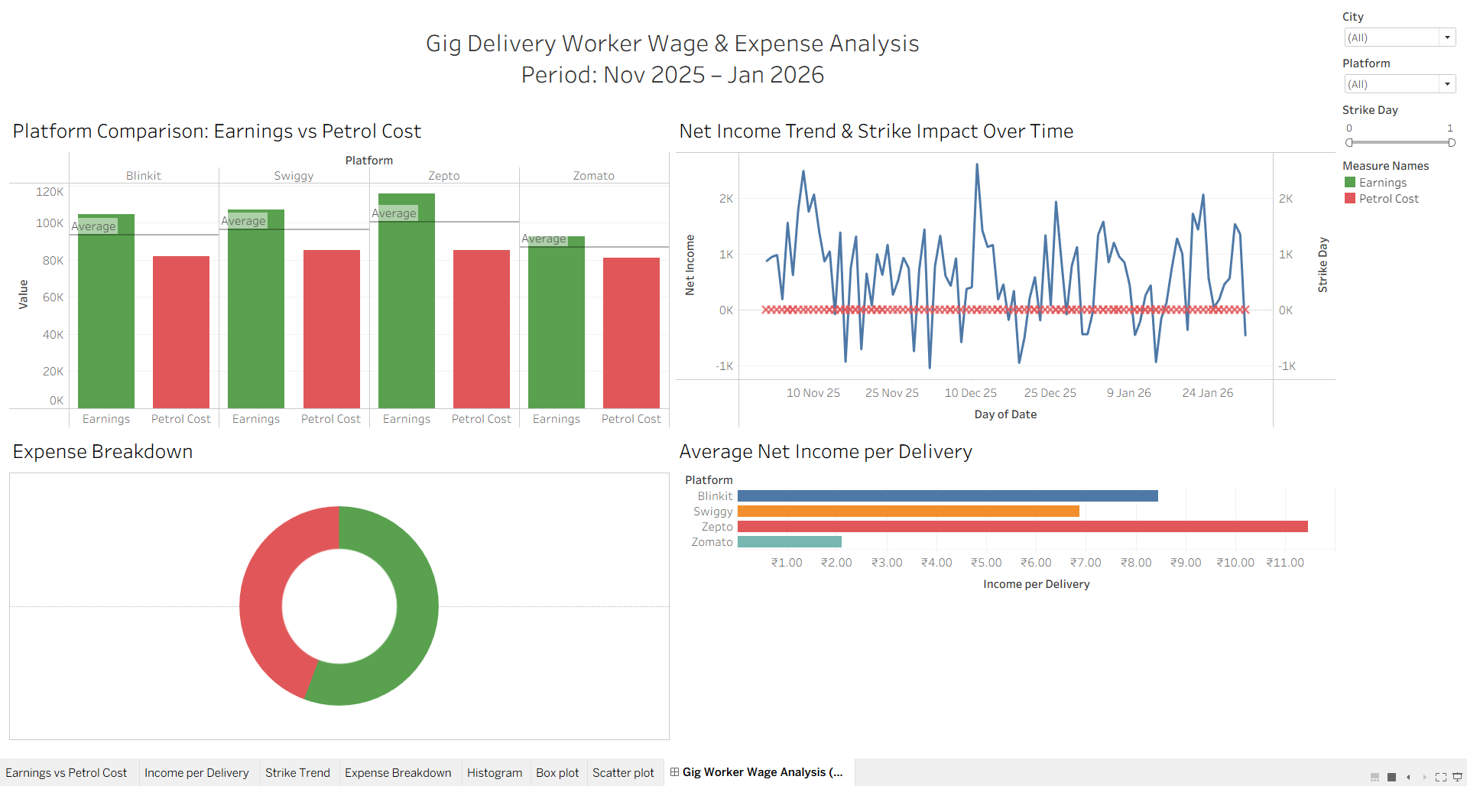

Slide 12
Conclusion
Gig workers’ profitability depends on:
Fuel efficiency
Distance traveled
Platform policies
Strike days
Data visualization helps uncover financial pressure points and wage fairness issues.

Slide 13


